Slide 1
2017-18 Winter season outlook
Michael Williams

Slide 2
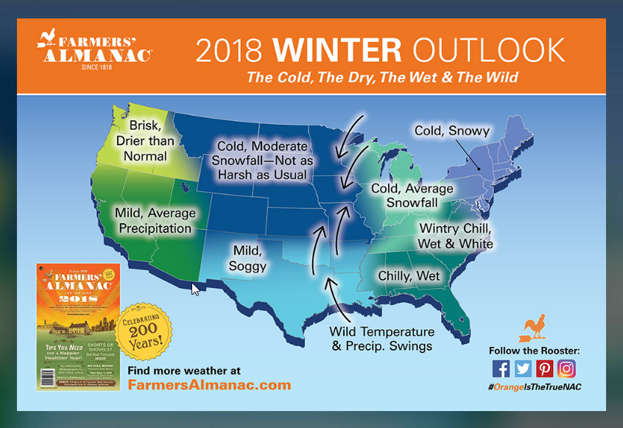
Farmer’s Almanac
Notes:
Farmers Almanac outlook for upcoming winter

Slide 3
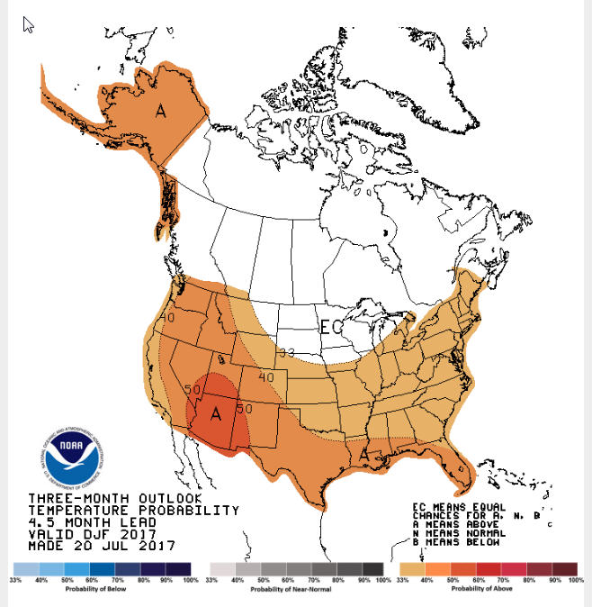
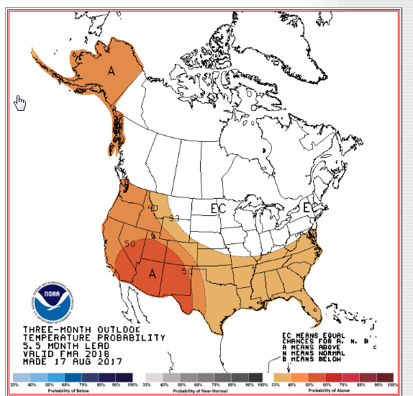
Winter Temp Outlook
(NOAA)
Nov-Jan Feb-Apr

Slide 4
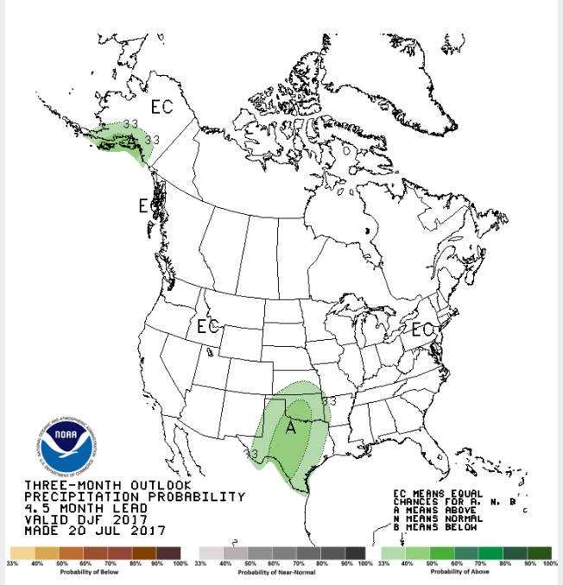
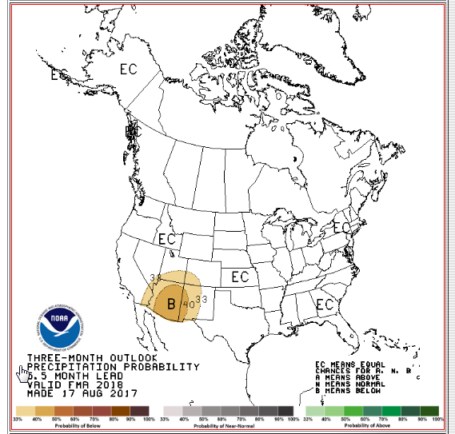
Winter Precip Outlook
(NOAA)
Nov-Jan Feb-Apr

Slide 5
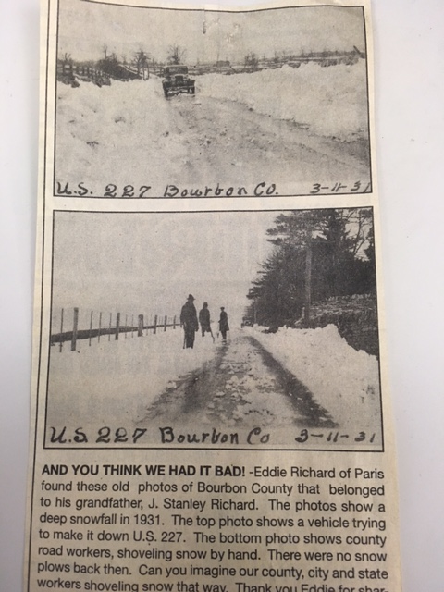

Slide 6
Current Salt Inventories
(As of 09/12/17) (As of 02/02/18)
301,700 tons at Maintenance Facilities (98% cap.) 182,900
180,000 tons in Underground Storage 165,000
481,700 on-hand 347,900
Salt Brine: 1,046,340 gallons 1,078,580
CaCl: 990,500 gallons 824,660

Slide 7
Material Usage
2016/17 Winter
2017/18 Winter (So far)
Salt: 64,400 Tons
Brine: 1,044,260 Gallons
CaCl: 231,340 Gallons
Cost: $28,570,565
Salt: 172,000 Tons
Brine: 458,000 Gallons
CaCl: 647,000 Gallons
Cost:

Slide 8
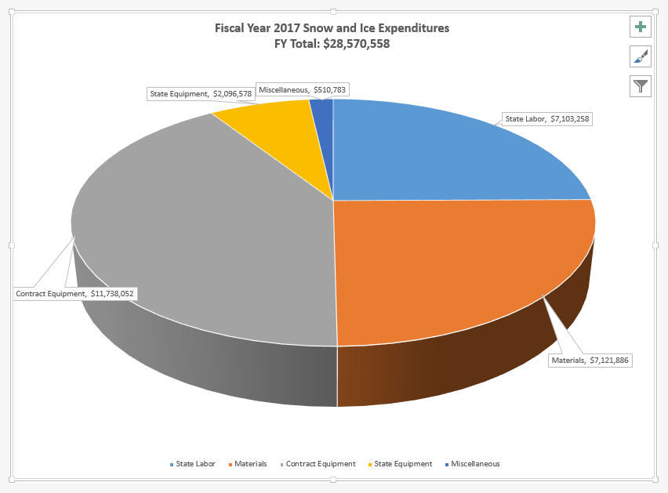
Winter 2016-17
Notes:
Breakdown of SNIC expenses for the 2014-15 winter season

Slide 9
Current Salt Prices
(District Averages)
D1: $56.50
D2: $59.48
D3: $63.46
D4: $57.00
D5: $53.00
D6: $56.88
Statewide Avg: $61.31
Currently at 98% cap.
D7: $58.70
D8: $67.30
D9: $57.50
D10: $64.50
D11: $71.10
D12: $70.30
Notes:
White salt prices are same as last year, no increases.

Slide 10
Priority System
Interstates | 1 hour response time
 | 1 truck/lane with a one-hour turn around
Priority A | 2 hour turn around time
 | 1 truck per two lanes
Priority B | 4 hour turn around time
 | 1 truck per two lanes
Priority C | 16 hour turn around time after A’s & B’s clear (Where practical, no work on C routes between 9:00 pm and 5:00 am)
 | 1 truck per two lanes
Notes:
Per Maintenance Manual guidelines

Slide 11
Route Optimization Project
Project began in 2015 with KTC.
Utilize software to optimize SNIC routes within a county and district.
Project successful with additional funds to continue for other districts.
Also, across county and district lines.
D6 and D7 pilot counties

Slide 12
Software Hurdles
State truck vs. contract truck
Single axle vs. tandem
Salt capacity of spreader
Route traversal times
Truck speed
Stop lights
Turn lanes
New way for drivers to address routes
Never been done before………

Slide 13
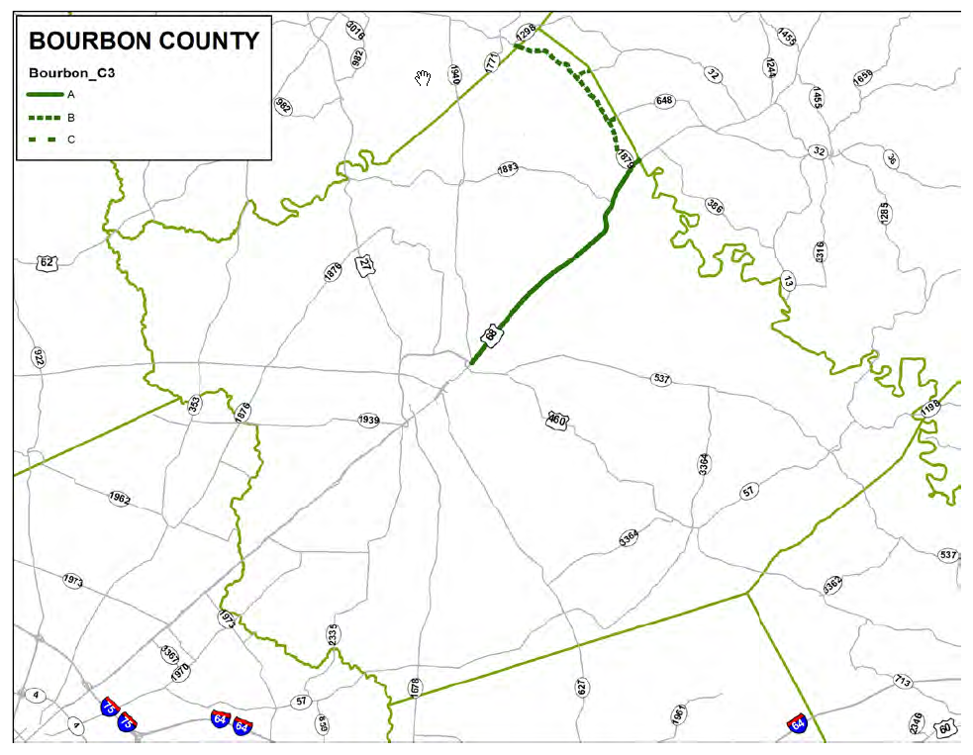

Slide 14
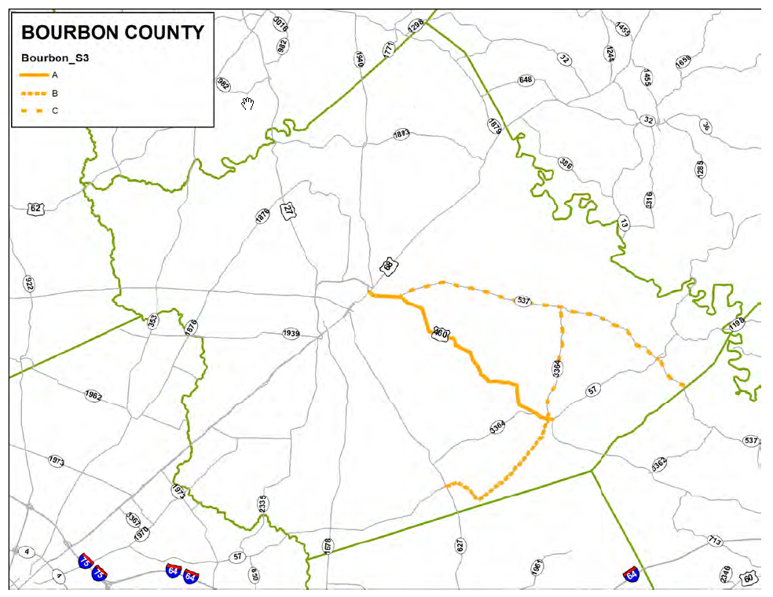

Slide 15
Schedule
D7 completed
D6 all but completed
D3, October through December
D4, January through March
D5, April through June
Remaining districts will be routed for the following season.
Data processing is being done up front for all districts so the latter part of project should proceed much quicker than first 6 districts.

Slide 16
New KTC Project
Selection and Use of Liquid Products for Anti-Icing
What are best products to use?
What is the best recipe to use?
Are other products cost effective?
What we are doing with brine and CaCl may well be the best approach.
2-year project has just begun.
Should have products and mixes available for trial late winter 2018
Lab and field trials

Slide 17
Product Mixes to Evaluate
Brine + CaCl 5% CaCl in solution
Brine + AG 64 20% AG 64 in solution (beet juice)
Brine + IB Magic 15% Magic in solution (vodka dist.)
Brine + Ice Ban 5% Ice Ban in solution (corn starch)
Brine + Freeze Guard CI 10% Freeze Guard in solution (MgCl)

Slide 18
Any Questions or Comments……………….
Michael.Williams@ky.gov
502-782-5616
502-330-5039

